Slide 1
现在完成时
  构成have/has + 过去分词
do my homework
I still live here
moved here
in 2000
my homework have finished
1.过去发生的动作对现在造成的影响或结果。
past
now
I have done my homework.
2.过去已经开始，持续到现在的动作或状态。
I have lived here for 11years.
I have lived here since 2000/11 years ago.

Slide 2
现在完成时动词构成
have /has+ v 过去分词(及物动词)
haven’t
hasn’t
否定
助动词
Have you……?
Has he……?
疑问
反问句 …… hasn’t../haven’t..?
答语 Yes, 主语+have/has.
No, 主语+haven’t/hasn’t

Slide 3
过去分词的构成
1.+ed work, plant,call
2.e+d live, change, like, love, agree, save, hate, move, arrive, skate, hope, use
3.以重读闭音节结尾，末尾只有一个辅音字母的 双写＋ed. 如：plan, stop, drop, fit(适合), prefer(更喜欢), travel
4.以辅音字母＋y，结尾，变y为i＋ed try, study, carry, hurry, cry, worry,copy
5.特殊:am/is/are-been, see-seen, do-done, go-gone, take-taken, give-given, know-known, speak-spoken write-written, sing-sung , forget-forgotten
6.不变： put-put , run-run, come-come

Slide 4
1.写出下列动词的过去式和过去分词
plant _____ ______ agree______ _______
plan _____ ______ stop ______ _______
study____ ______ carry______ _______
am/is ____ _____ are_____ _______
see _____ ______ do ______ ______
go ______ ______ give ______ ______
take _____ ______ know ______ ______
speak _____ _____ write ______ ______
put _____ _____ run _____ _______
come _____ _____ sing ______ ______
forget _____ ______ become_____ ______
planted planted
agreed agreed
planned planned
stopped stopped
studied studied
carried carried
was been
were been
saw seen
did done
went gone
gave given
took taken
knew known
spoke spoken
wrote written
put put
ran run
came come
sang sung
forgot forgotten
became become

Slide 5
标志词: already(肯定句) yet(否定句和疑问句 句末)
never（否定句，ever just
before(句末）so far, these days, since, for+ 时间段
already ---------- yet 已经
用于肯定句 用于否定句，疑问句
1.She has not seen this film .
She has seen this film.
2.I have combed my hair.
Have you combed your hair .
3.He has watched a video.
He has not watched a video .
yet
already
already
yet
already
yet

Slide 6


1.Have you ________ been to Beijing?
2.I have finished my work_______.
3.Have you finished your work______?
4.She has taught English _____ 10 years.
5.He has worked in the school ______
three years ago.
6.I have heard of the story _______.
ever
already
yet
for
since
before
3.标志词：
just, yet; since, for;
ever, never; already, before

Slide 7
have lived
1.The Greens ___________(live) here for almost ten years.
2.He _____________(work) in the factory since 1994.
3.His parent ___________(teach) in this school since they came to the city.
4.The child_________(sleep)since two hours ago.
has worked
has taught
has slept

Slide 8
have done
5 I ________ (do) my homework already.
6 He _____________(not finished) his homework yet.
7 _______you ever ______ (be) to Haiwaii?
8 We ______ never ______ (see) such an exciting match before.
9 Mother _____ just _______(clean) the house. Please don’t come in.
10 They _________________(practice) this dialogue twice.
has not finished
Have
been
have
seen
has
cleaned
have practiced

Slide 9
haven’t heard
11 I _____________( not hear) from her yet.
12 _____they _______(be) here recently?
Yes, they have.
13 I ___________(be) busy recently.
14 ---_____your father ever ______ (travel) to New York?
---No, never.
15 He __________________(not travel) by plane yet.
Have been
have been
Has travelled
hasn’t travelled

Slide 10
have/has gone to have/has been to have/has been in
have/has gone to:去了没回；
have/has been to:去过已回;
have/has been in:停 留一段。

Slide 11
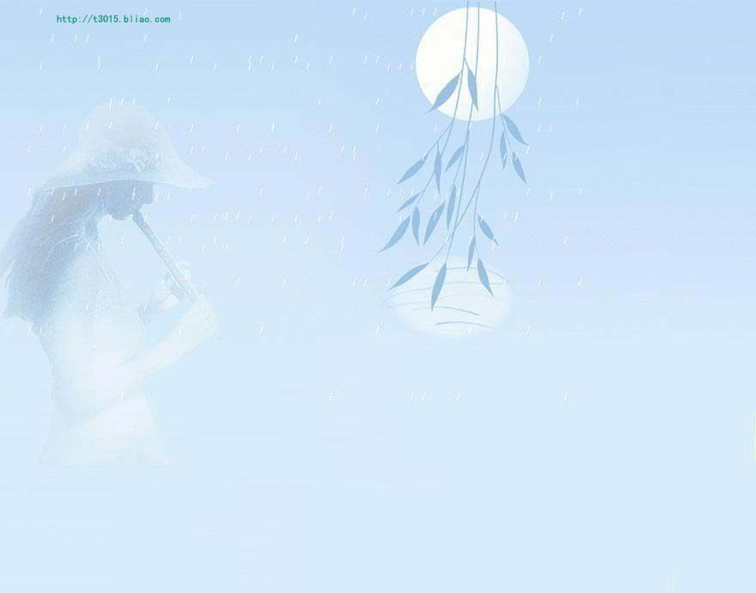
练一练：
1. Where is your father ?
He _____ _____ _____ London.
has gone to
2. How many times _____
you _____ _____ Beijing? Never.
have
been to
been in
3 How long Peter the West Hill?
has
4. I can’t find your mother.
Oh, she ____ ____ ____ the cinema.
has gone to
5. I _____ never _____ _____ France.
have been to

Slide 12
注意点一：
现在完成时与一般过去时的用法比较
现在完成时不能和表示过去的时间状语连用。 如：yesterday, last night, two weeks ago, just now等
试比较：
The plane has arrived . 飞机已经来了。
（说明现在的情况：飞机在这儿）
The plane arrived a quarter ago. 飞机是一刻中以前来的（强调动作发生的时间在过去）

Slide 13
1. —I have watched the game.
—When ____ you ____ it?
A. have; watched B. do; watch C. did ;watch D. will; watch
C
B
2----When you your old friend?
----The day before yesterday.
A will, visit B did ,visit C have ,visited
D
3. —Excuse me, ____ you seen the film yet?
—Yes, I _____ it last night.
A have, see B have, have seen C have, seen D have, saw

Slide 14
注意点二、非延续性动词与现在完成时
短暂性动词可以用于现在完成时，但不能与
时间段连用。这些动词是：become, begin,
buy, borrow, arrive, come, die, finish,
go, join, leave, marry等。
I have borrowed this book.
I have borrowed this book for three days.（错）
I have kept this book for three days.
非延续性动词要转化成延续性动词才能和时间段连用。

Slide 15
She has bought the computer for two years.
had
buy
have/has had

Slide 16
I have borrowed the dictionary since 3 days ago .
kept
borrow
have/has kept

Slide 17
His dog has died for two years .
been dead
die
have/has been dead

Slide 18
How long have you come to the United States？
been in
come to
have/has been in

Slide 19
Ann has gone to China since three months ago.
been in
go to
have/has been in

Slide 20
I have got to Paris for one week .
been in
got to
have/has been in

Slide 21
My brother has joined the army for five years.
been in
been a soldier
have/has been in
join
have/has been a soldier

Slide 22
I have left Shanghai for 3 days.
been away from Shanghai
leave
have/has been away

Slide 23
The film has begun for 10 minutes.
been on
begin
have/has been on

Slide 24
The concert has finished for half an hour.
been over
finish
have/has been over

Slide 25
1.I have borrowed the book for 2 weeks.
( )
2.The film has begun for 5 minutes.( )
A B C
B kept
B been on
A B C
3. 这辆自行车我买了两年了。
I’ve _____ the bike _____ two years.
had for
4. He left Nanjing two years ago.
He _____ _____ _____ _____ Nanjing for two years.
has been away from
5. The monkey died last month.
The monkey _____ _____ _____ for a month.
has been dead
6. A: Hong long _____ you ____ ( )
B: Two weeks.
A.did,get ill B. have,fallen ill C. were,ill D. have,been ill
D

Slide 26
The Past Perfect Tense
过去完成时
过去完成时的构成
助动词 had + 过去分词
(用于各种人称和数)
2. 过去完成时态的含义:
主要是表示在过去某个时间,或是动作之前
已经发生或完成的动作.也就是：
过去的过去.

Slide 27
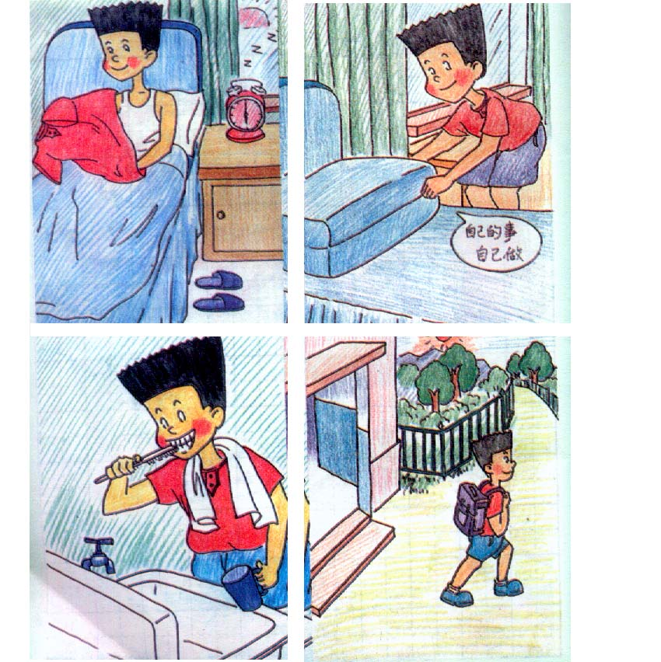

Last Sunday
now
6:30
9:00
got up
By the time Jim ________, his mom _______
had cleaned..

Slide 28

Last Sunday
6:50 9:00 now
got up
By the time Jim ________, his sister _______
had washed..

Slide 29
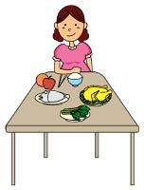
Last Sunday
now
9:00
got up
By the time Jim ________, his grandma _______
had eaten..

Slide 30

Last Sunday
now
9:00
got up
had gone…
By the time Jim ________, his dad _______

Slide 31
6:00
6:10
6:25
6:40
7:10
got up
took a shower
went to work
did sports
washed clothes
﹜
When
I did sports , I had gotten up .
By the time
﹜
When
I took a shower , I had done sports .
By the time
（到……时候，到……之前）后接一般过去时的句子，
主句用过去完成时。

Slide 32

她出去的时候,公共汽车已经开走了.
By the time she got outside, the bus had already left.
by the time 意思是 “到…的时候”,
相当于 when , 后接过去时的句子
时, 主语的谓语动词用过去完成时态.

Slide 33
过去完成时态的时间标志用法：

Slide 34
① by (到…为止) ＋ 过去时间
如：We had finished the article by last Monday.
② by the end of （到…末为止）＋ 过去时间
如：We had learned nine units by the end of last week.
③ before ＋ 过去时间
如：They had gone to school before 5:00 this morning.
④ before ＋ 从句（一般过去时）
如：The train had left before I got to the station.
⑤ when / by the time ＋ 从句（一般过去时）
如：When / By the time I got home, she had
already gone to bed.
此外，过去完成时还可用于宾语从句中。
如：He told a radio interviewer that he had run
out of money to buy old bikes.
﹋﹋
﹋﹋
﹋﹋

Slide 35
到去年为止，我已经学了大约一千个英语单词。
① By the end of last year, I had learned about one thousand English words
② By the time he was twenty, he had won about ten medals
③ When I got there, they had already left
在他二十岁的时候，他已经赢了大约十块奖牌。
当我到那的时候，他们已经离开了。

Slide 36
用所给动词的适当形式填空：
1. By the end of last week, we _____________ (study) 9 units.
2. We _____________(reach) the station before
ten o’clock this morning.
3. When I got there, he _____________(play) tennis for
half an hour.
4. He said he ______never ______(see) such an exciting film before.
5. By the time she was five, she ____________（learn）
ten English songs.
6. When he came in, I ______ just ____________(finish) my
homework.
7. Before I ______(leave) home yesterday, I ______________
(clean) the house.
8. She told me that she ___________(read) the novel already.
9. Mr. Li ______________ (teach) for ten years before he
came here.
10.By the time I got to the cinema, the film ____________(be)
on for ten minutes.
had studied
had reached
had played
had seen
had learnt
had finished
left
had cleaned
had read
had taught
had been

